Slide 1


Slide 2
Content
1
Concurrent computing
2
Advantages
1
Performance
2
Resource utilization
3
Latency decreasing
3
Wonders
1
Races
2
Complexity
3
Tech issues
4
Conclusion

Slide 3

Inspiration

Slide 4
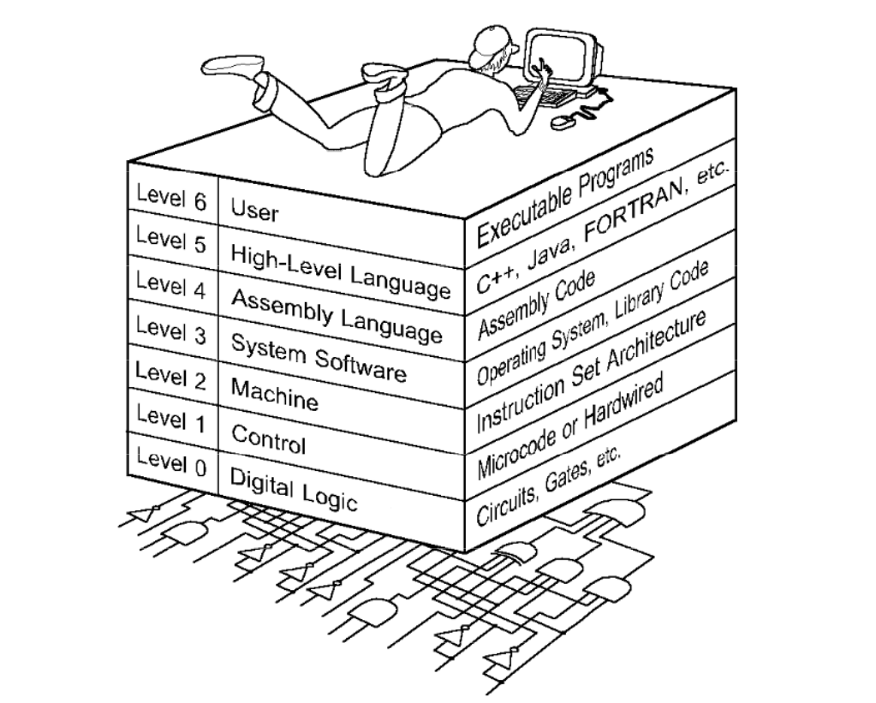
The World we are living in

Slide 5
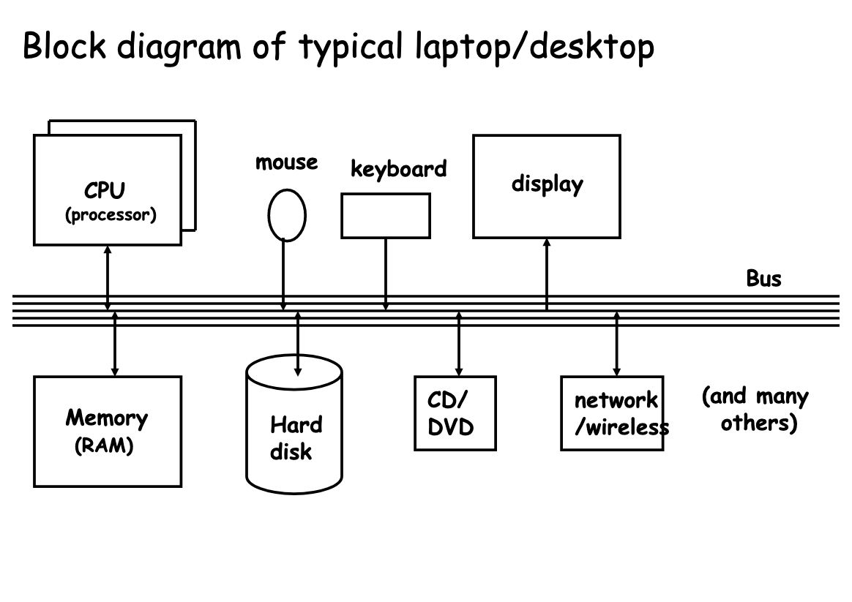
How computer work?

Slide 6
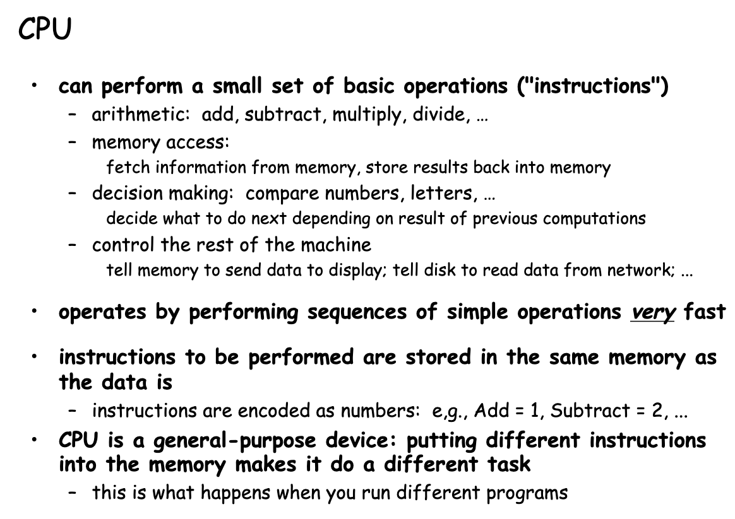
How processors work?

Slide 7
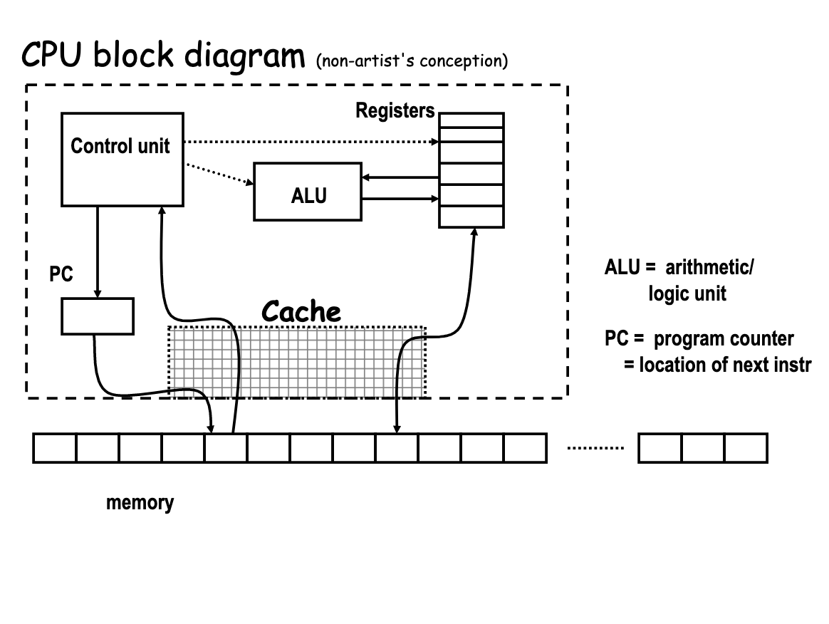
How processors work?

Slide 8
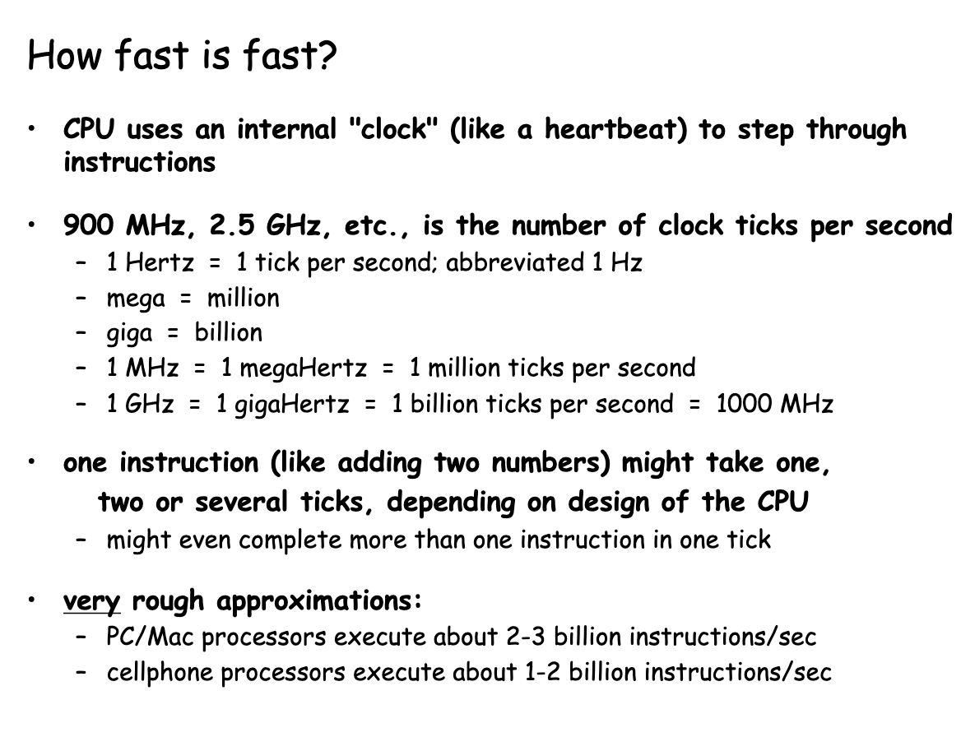
How processors work?

Slide 9
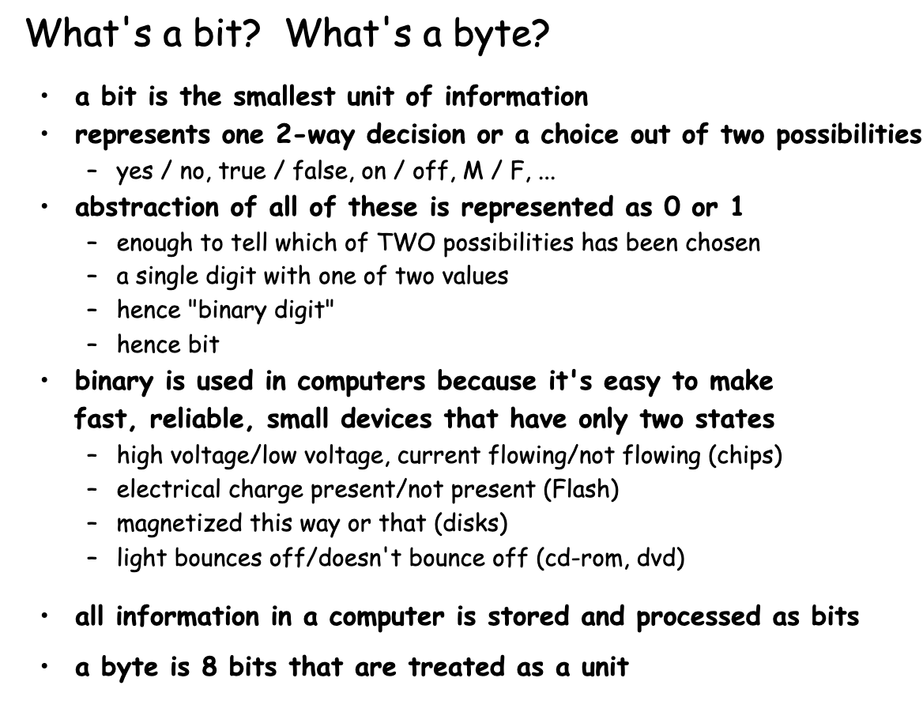
How processors work?

Slide 10
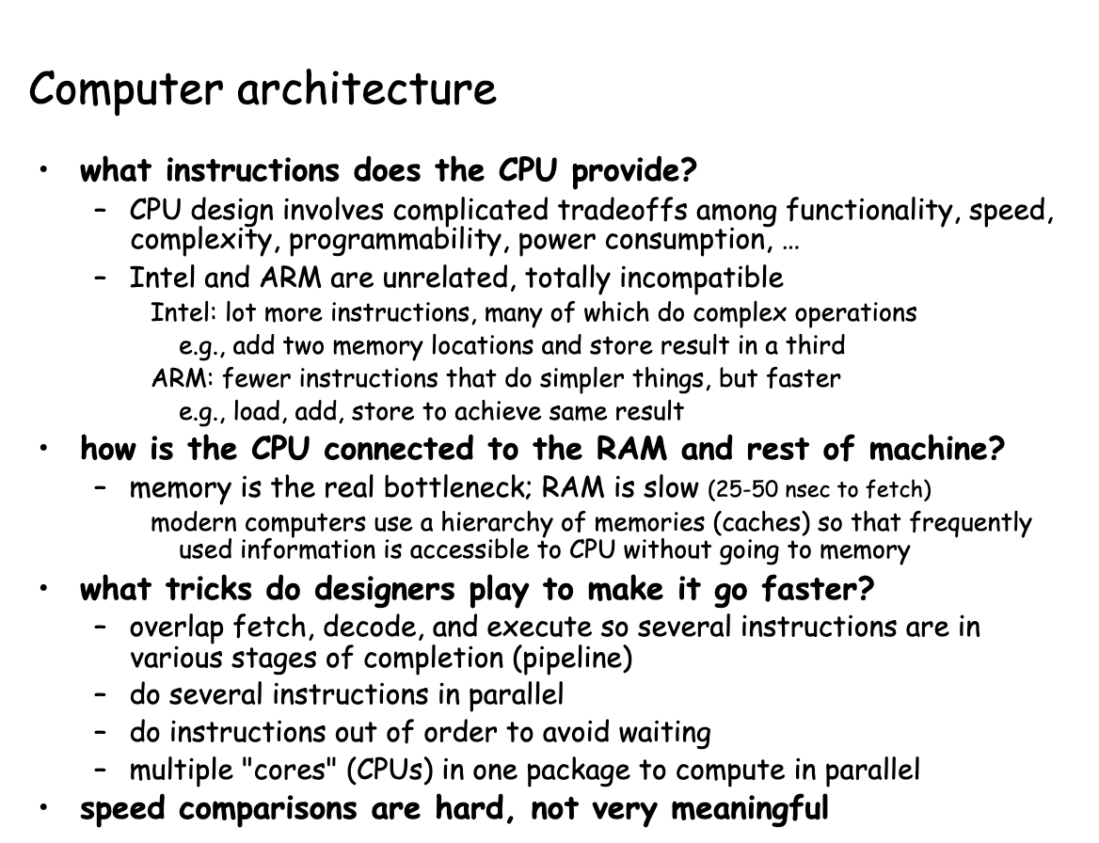
How processors work?

Slide 11
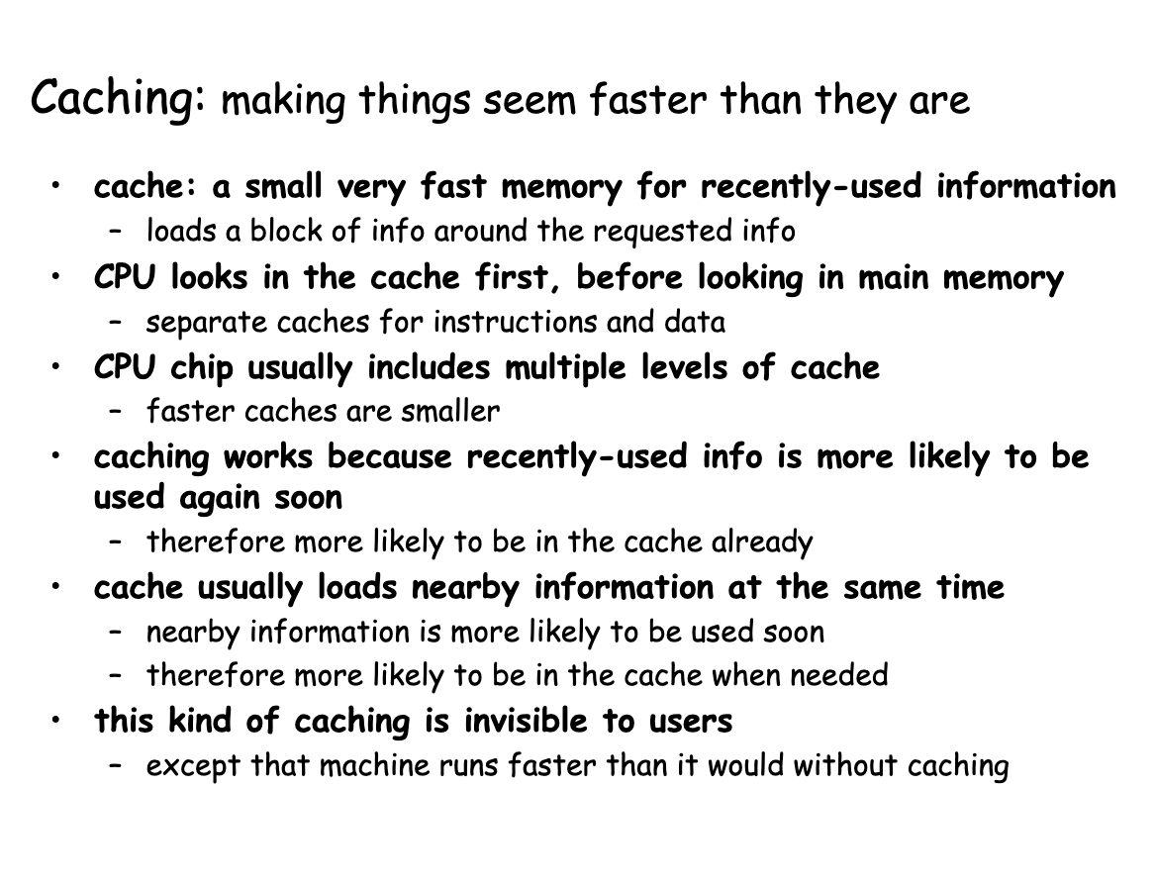
How processors work?

Slide 12
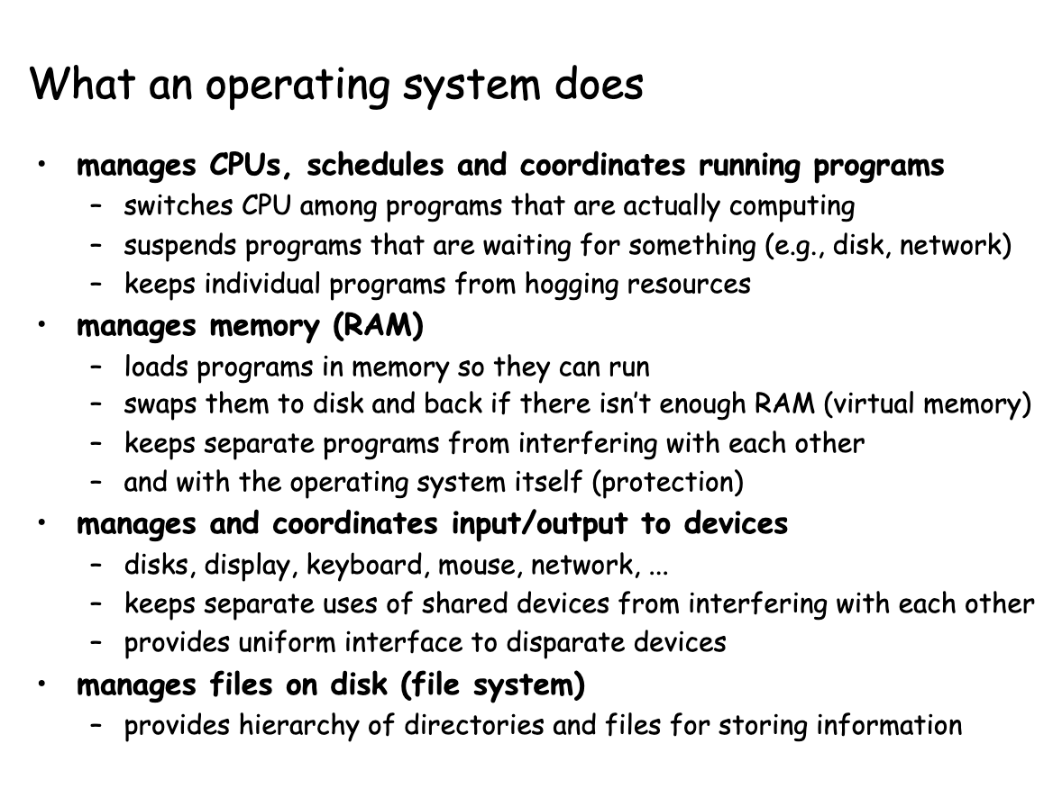
How processors work?

Slide 13
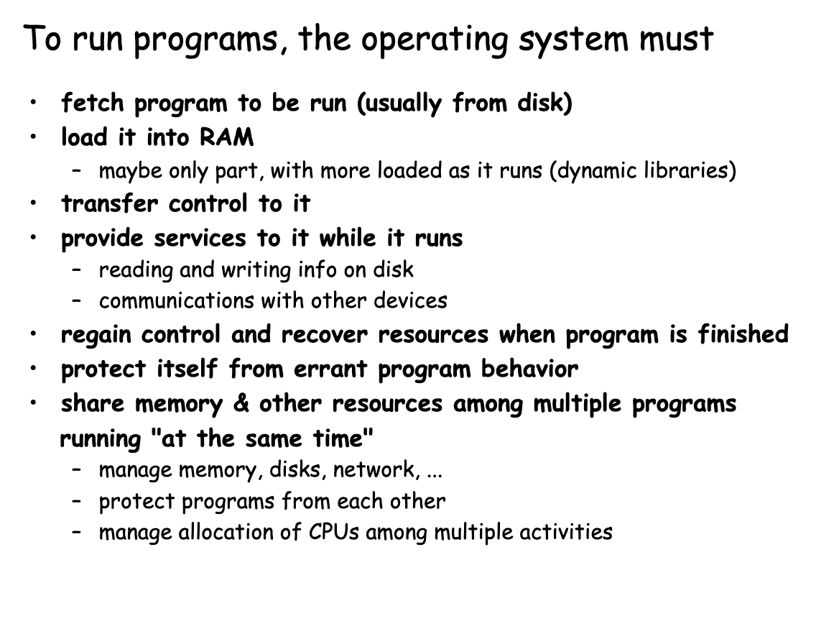
How processors work?

Slide 14
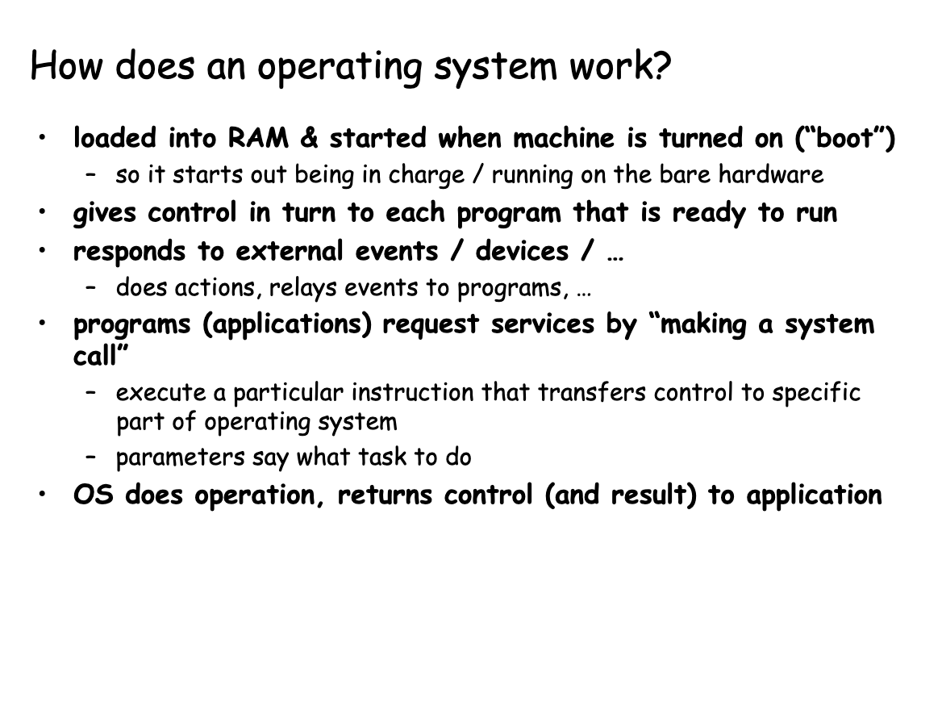
How processors work?

Slide 15
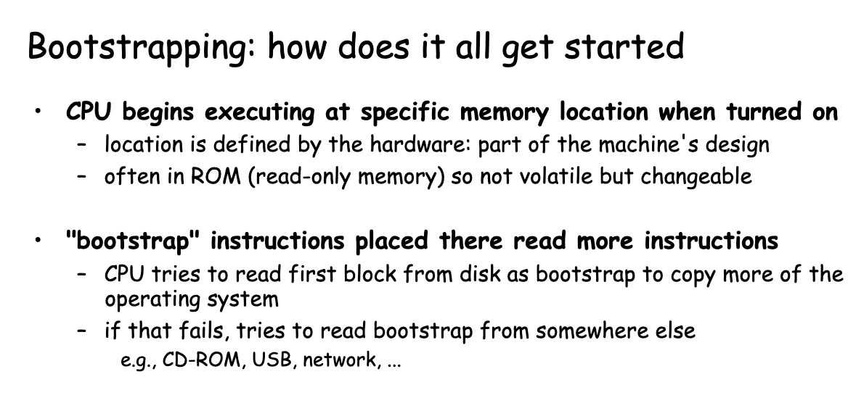
How processors work?

Slide 16
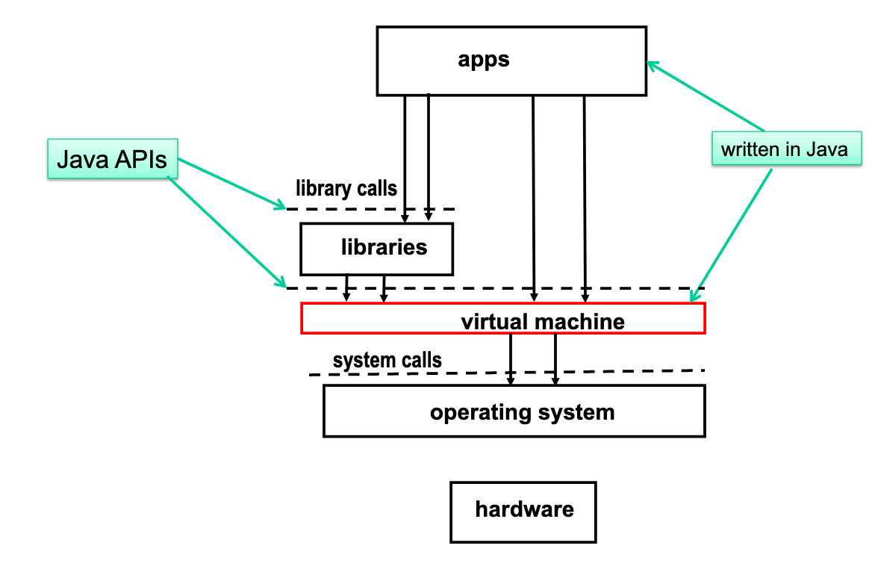
How processors work?

Slide 17
How processors work?

Slide 18
Concurrent computing is a form of computing in which several computations are executed during overlapping time periods—concurrently—instead of sequentially (one completing before the next starts)
Definition

Slide 19
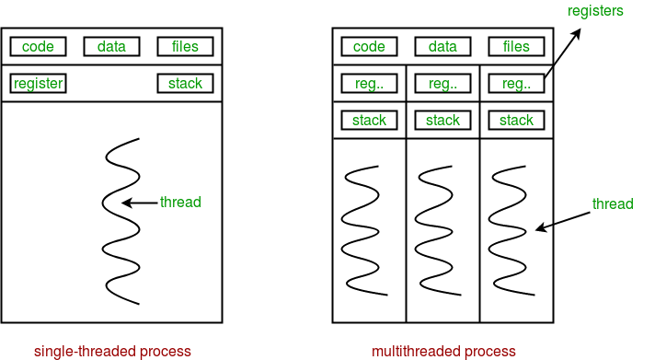
Sequential vs concurrent

Slide 20
Performance

Slide 21
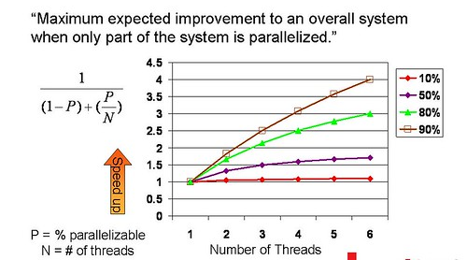
Amdahl's law

Slide 22
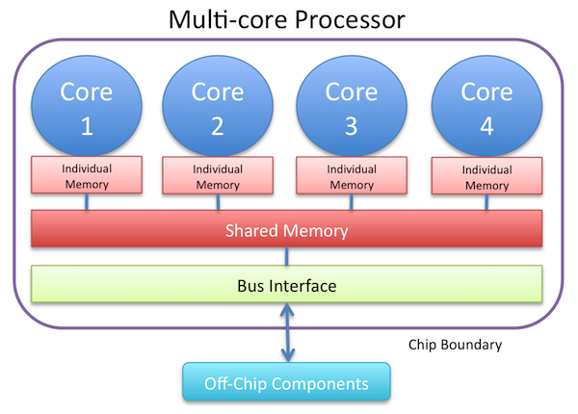
Resource utilization

Slide 23
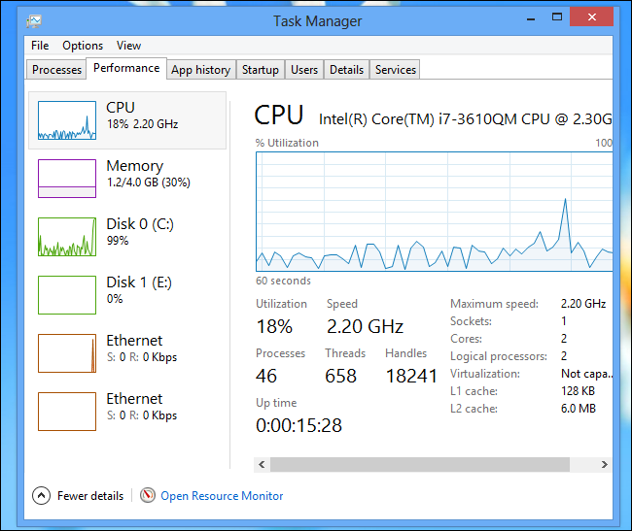
Resource utilization

Slide 24
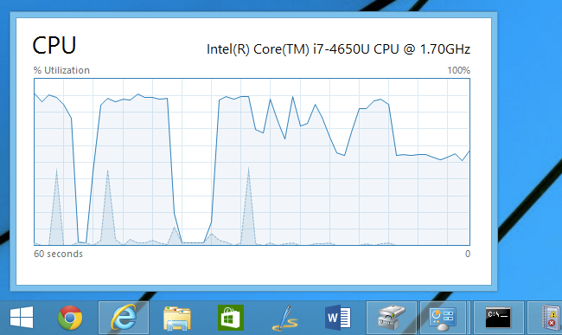
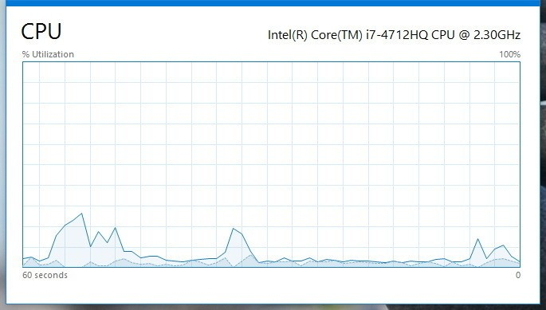
Resource utilization

Slide 25
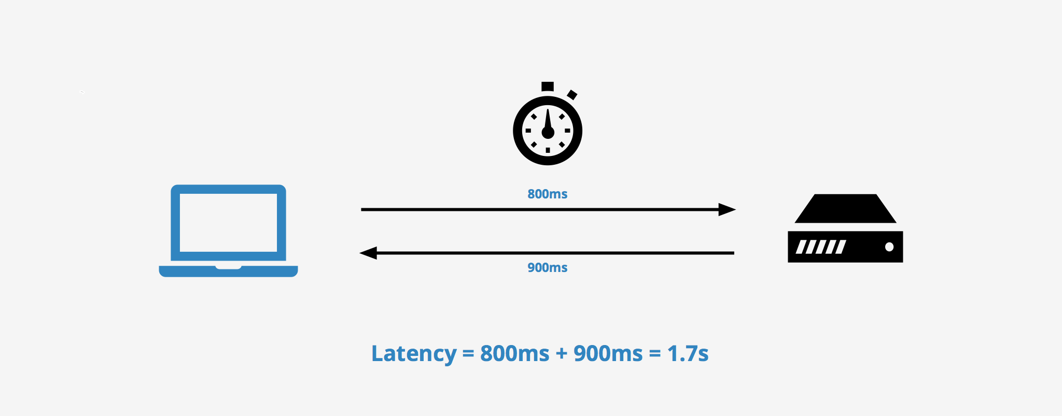
Latency

Slide 26

Modern way

Slide 27
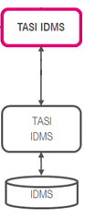
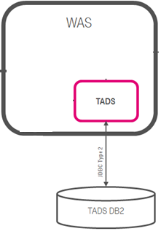
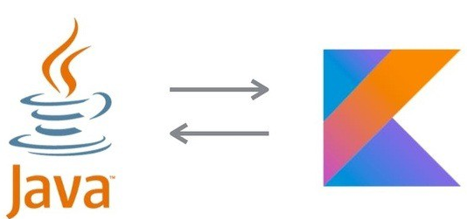
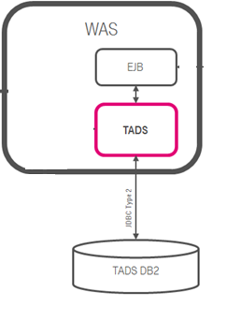
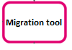

Concurrent Dijkstra algorithm

Slide 28
Multi thread migration

Slide 29
Single thread migration
7h21 min 1.7 r/s

Slide 30
Multi thread migration

Slide 31
Multi thread migration
7h21 min 1.7 r/s
28 min 23 r/s

Slide 32

The show begins

Slide 33
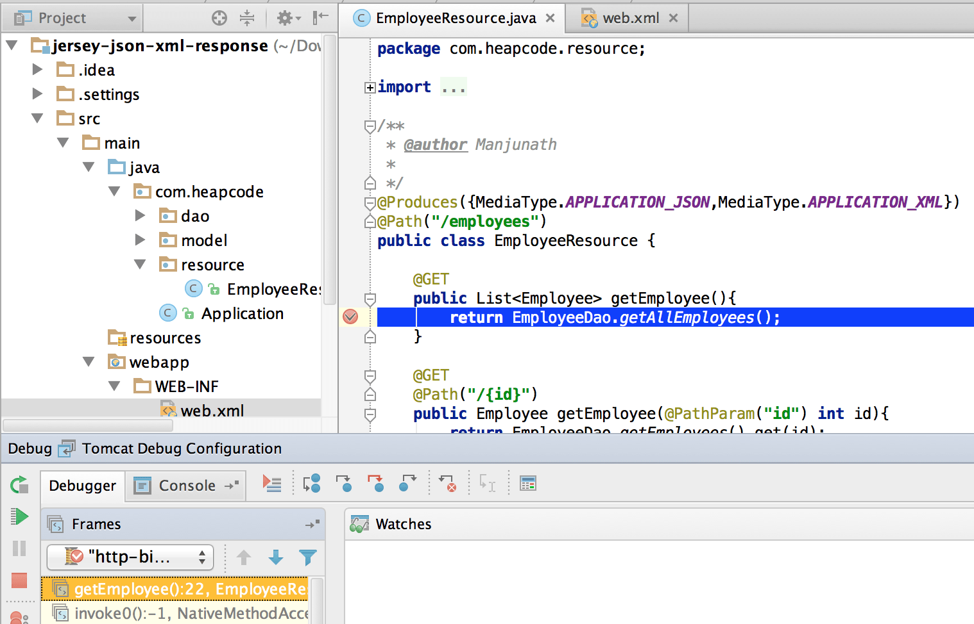
#1 Difficult to debug

Slide 34
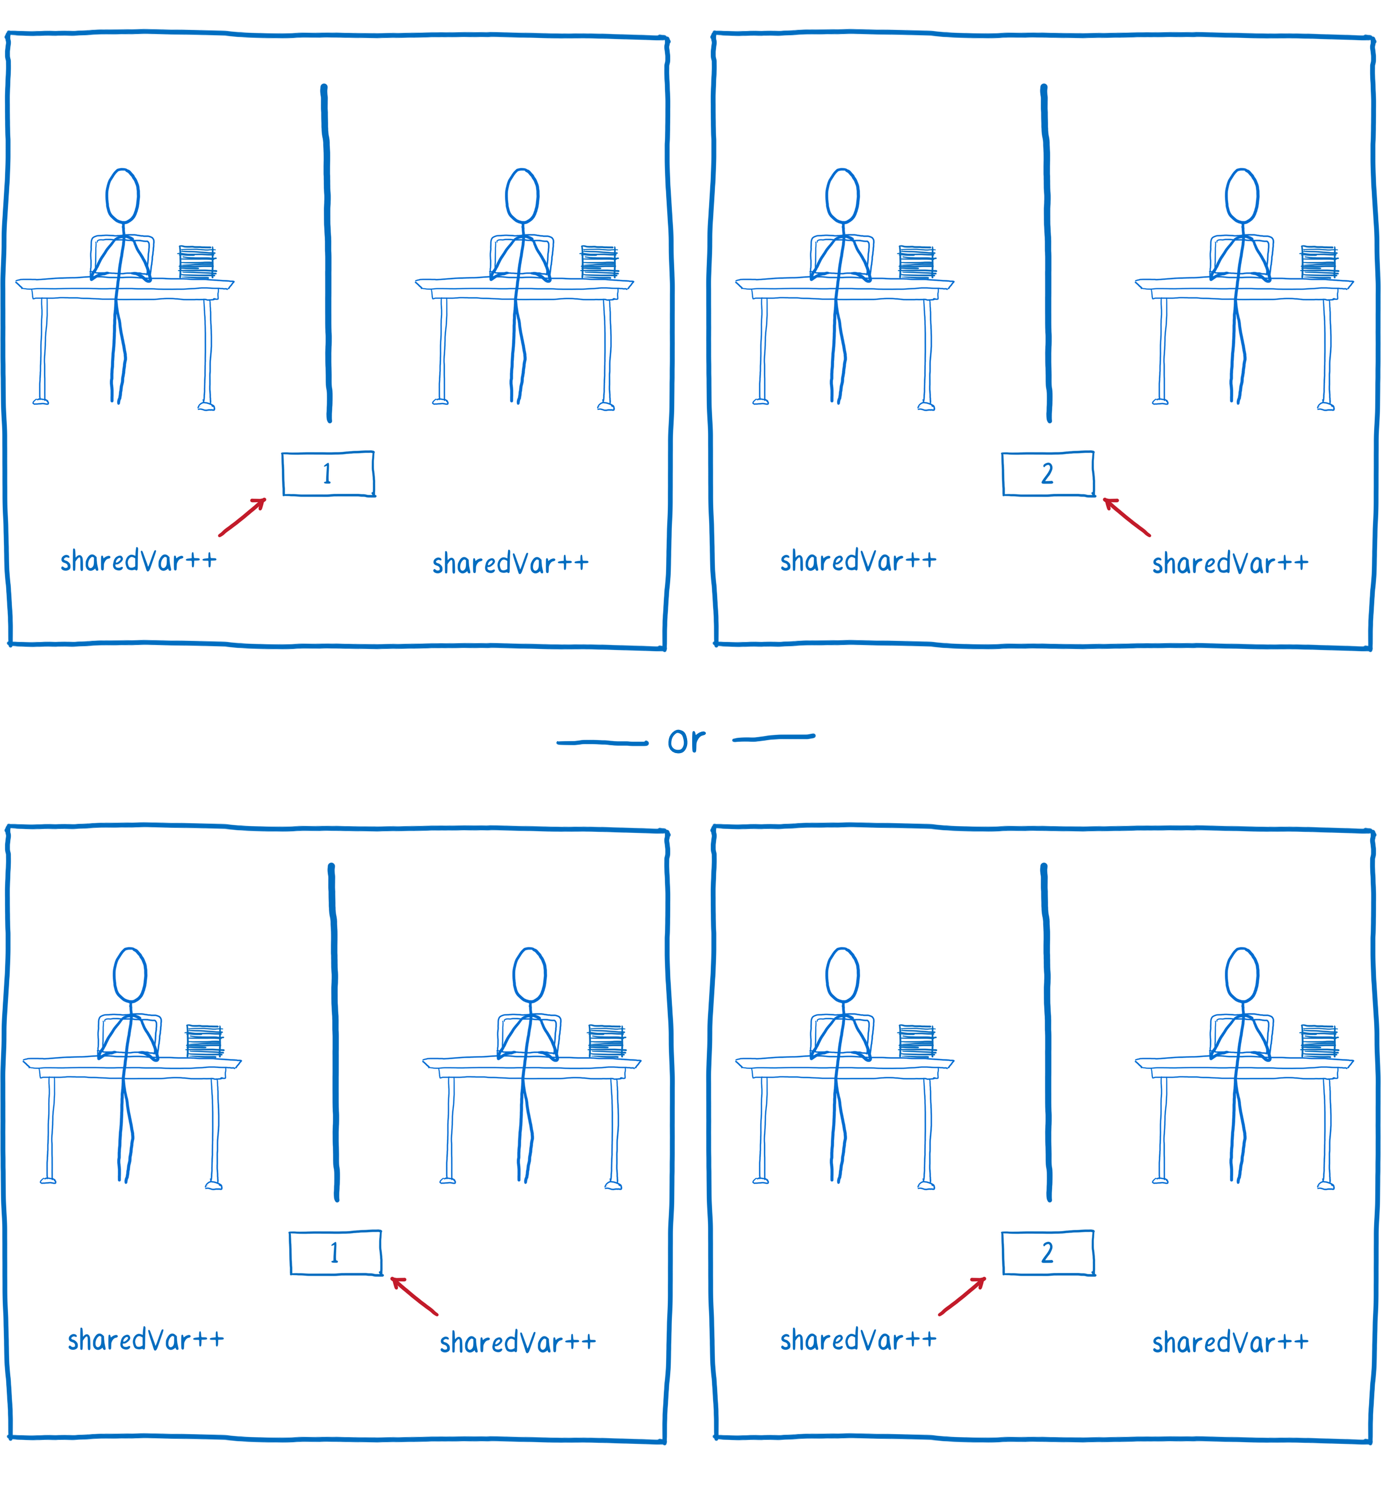
#2 Race condition

Slide 35
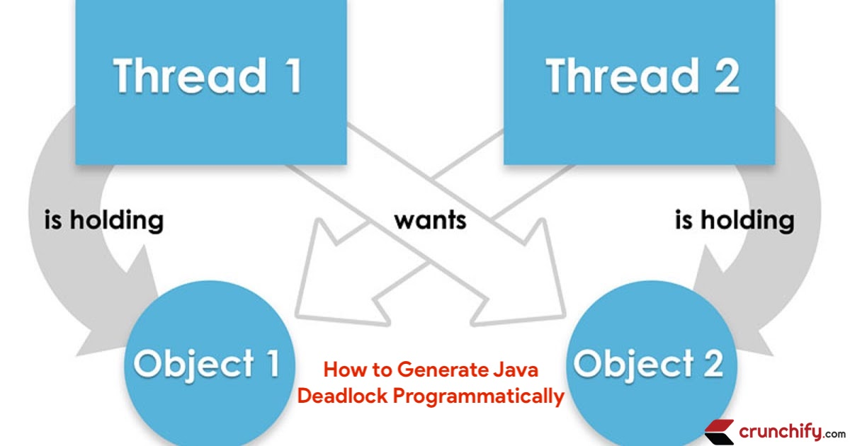
#3 Dead locks

Slide 36
Concurrency mad stuff
“But I don’t want to go among mad people," Alice remarked. - "Oh, you can’t help that," said the Cat: "we’re all mad here. I’m mad. You’re mad." - "How do you know I’m mad?" said Alice. - "You must be," said the Cat, "or you wouldn’t have come here.”
Alice's Adventures in
Wonderland by Lewis Carroll

Slide 37
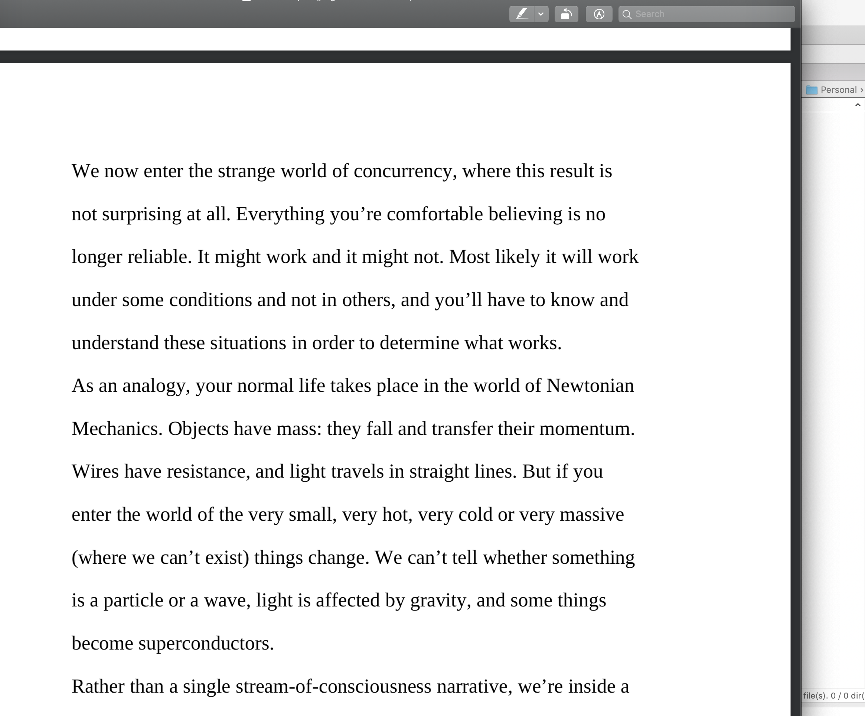

Dev practices
On Java 8 by Bruce Eckel

Slide 38
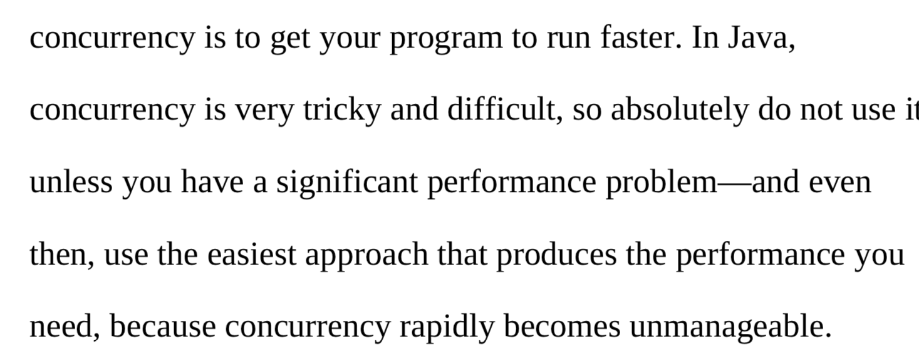
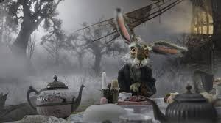
Dev practices
On Java 8 by Bruce Eckel

Slide 39
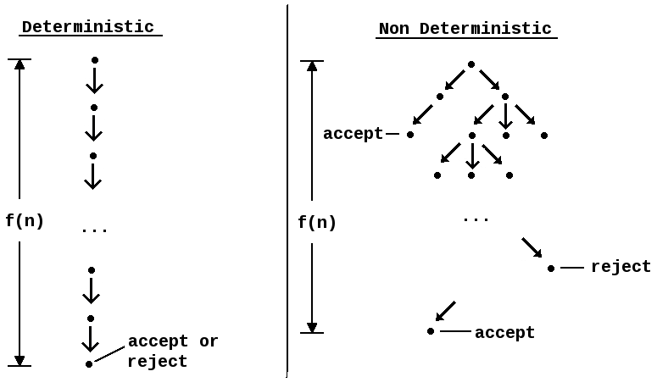
#4 Non deterministic behavior

Slide 40
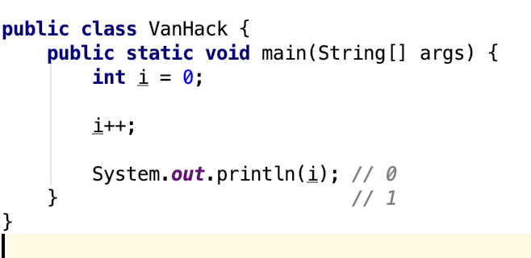
#4 Non deterministic behavior

Slide 41
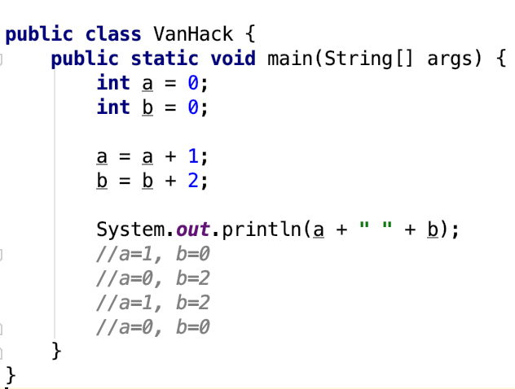
#4 Non deterministic behavior

Slide 42
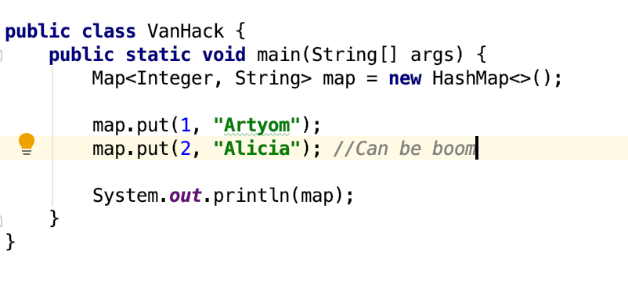
#4 Non deterministic behavior

Slide 43
Are you still here?
Twas brillig, and the slithy toves Did gyre and gimble in the wabe: All mimsy were the borogoves, And the mome raths outgrabe
Jabberwocky by Lewis Carroll

Slide 44

Let’s continue?

Slide 45
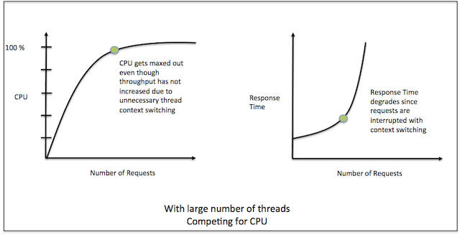
#5 Performance degradation

Slide 46
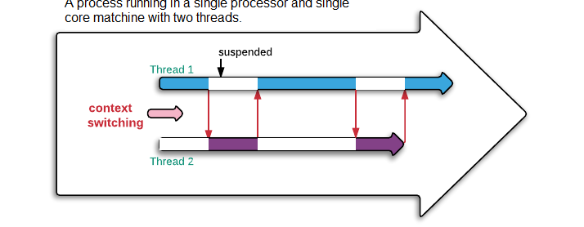
#5 Performance degradation

Slide 47
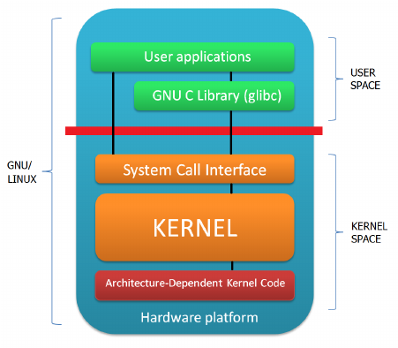
#6 OS limitation

Slide 48

Stop it? Hell no…

Slide 49

#7 Hardware unpredictable optimizations

Slide 50
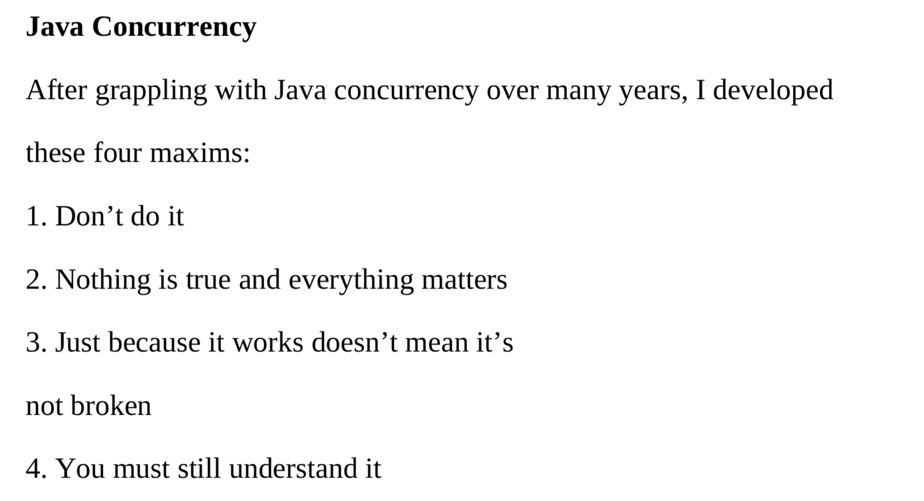
Concurrency in real world
On Java 8 by Bruce Eckel

Slide 51
Conclusion
Concurrency is powerful practice, you can achieve a lot using it
Don’t use concurrency if you can avoid it
Use best practices by experts
Use frameworks with big professional community
Minimize synchronization and data sharing
Perform load and stress testing
Use as much as possible existed solutions
Don’t forget about mad world and wonders

Slide 52
Resources
Java concurrency in practice (Brian Goetz )
On Java 8 (Bruce Eckel)
The Art of Multiprocessor Programming (Maurice Herlihy , Nir Shavit )

Slide 53
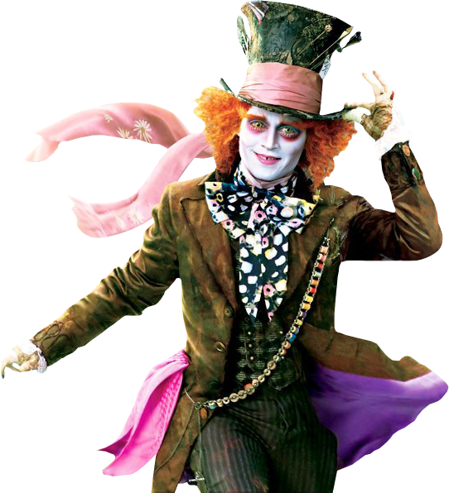
THANK YOU!
artyom-karnov@yandex.ru, Saint-Petersburg, 2019

